Slide 1
KPMG & Sprocket Central Pty Ltd
Data analytics approach
Srikrishnan S
Email: srikrishnan214@gmail.com

Slide 2
Topics Covered in this Presentation
Introduction
Data Quality Assessment
Data Pipeline (ETL - Extract, Transform & Load)
Data Modeling (Dimensional Modeling – Star Schema)
Customer Segmentation (RFM Segmentation)
Data Visualization & Dashboard
Exploratory Data Analysis & Statistical Testing
Conclusion
End

Slide 3
Introduction
Sprocket Central Pty Ltd , a medium size bikes & cycling accessories organisation, has approached Tony Smith (Partner) in KPMG’s Lighthouse & Innovation Team. Sprocket Central Pty Ltd is keen to learn more about KPMG’s expertise in its Analytics, Information & Modelling team.
Smith discusses KPMG’s expertise in this space (you can read more here). In particular, he speaks about how the team can effectively analyze the datasets to help Sprocket Central Pty Ltd grow its business.
Primarily, Sprocket Central Pty Ltd needs help with its customer and transactions data. The organization has a large dataset relating to its customers, but their team is unsure how to effectively analyze it to help optimize its marketing strategy.
However, in order to support the analysis, you speak to the Associate Director for some ideas and she advised that “the importance of optimizing the quality of customer datasets cannot be underestimated. The better the quality of the dataset, the better chance you will be able to use it drive company growth.”
The client provided KPMG with 3 datasets:
Customer Demographic
Customer Addresses
Transactions data in the past 3 months
You decide to start the preliminary data exploration and identify ways to improve the quality of Sprocket Central Pty Ltd’s data.

Slide 4
Data Quality Assessment
Many empty columns were present in the Data’s, mostly from column no 14 to column no 256.
Many Null Values were present on both the Transactions Table and Customer Demographics Table.
Data’s were inconsistent on both Customer Demographic Table and Customer Address Table, especially on gender & state.
A anonymous column named “default” was present on the Customer Demographic Table.
Product First Sold Date column in Transactions Table was incorrect Data Type, so we had to change from int to date format.
Removed Deceased Customers in Customer Demographic Table.
Age with 180 years

Slide 5
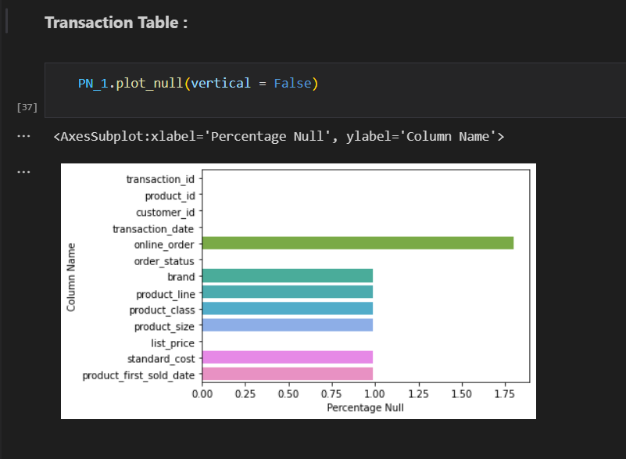
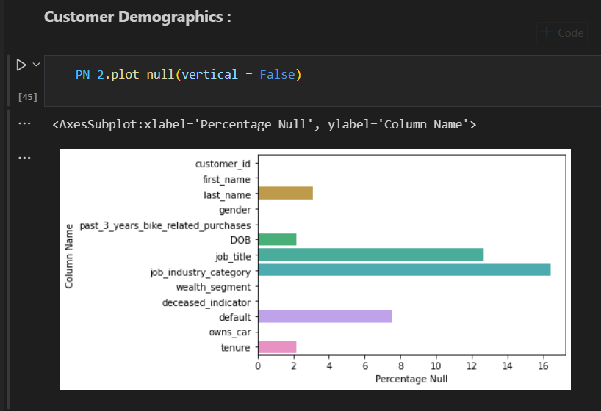
Data Quality Assessment
Some of the Null Values reported in the Raw Tables.

Slide 6
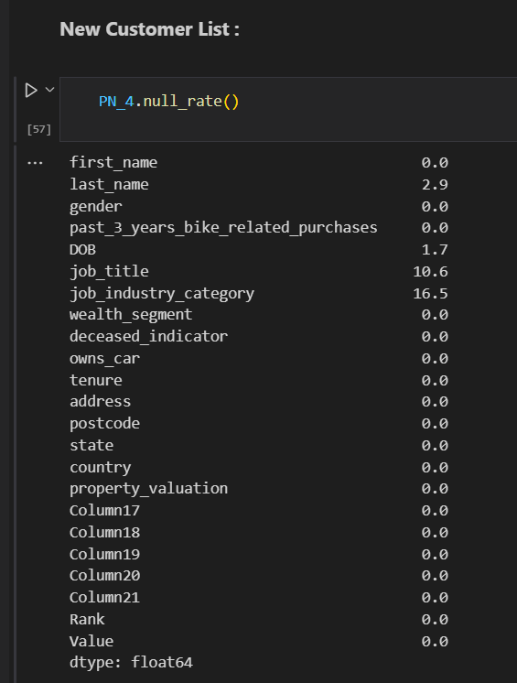
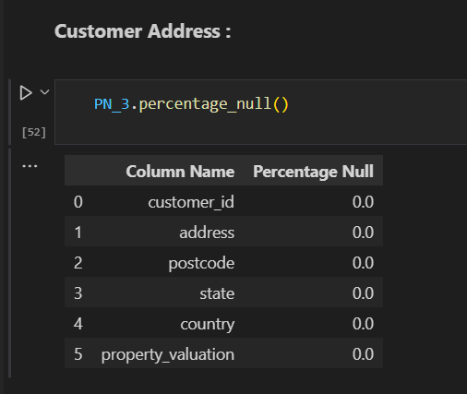
Data Quality Assessment
Some of the Null Values reported in the Raw Tables.

Slide 7
Data Pipeline (ETL-Extract, Transform & Load)
Truncate Raw Tables using SQL Execution Task.
Extract and Load the Raw Tables into Sprocket KPMG Stagging Database, using Multiple Data Flow Task inside Sequence Container.
Filter out the Null Values & Deceased Customer records using Conditional Split Function inside Data Flow Task, and export them into separate Flat File to report the Quality of the Data.
Transform the Data Inconsistency in the Raw Tables using SQL Execution Task.
Build a Working Table that Combines all the Raw Tables into a Single Table and Filtered out the late arriving Dimensions using Data Flow Task.
Build a Dimensional Model inside the Sprocket KPMG Stagging Database to split the Tables.
Load the Fact and Dimension Tables inside the Sprocket KPMG Warehouse using Data Flow Task.
Implement Check Constraints Statements inside Sprocket KPMG Warehouse to establish Primary Key and Foreign Key Constraints.

Slide 8
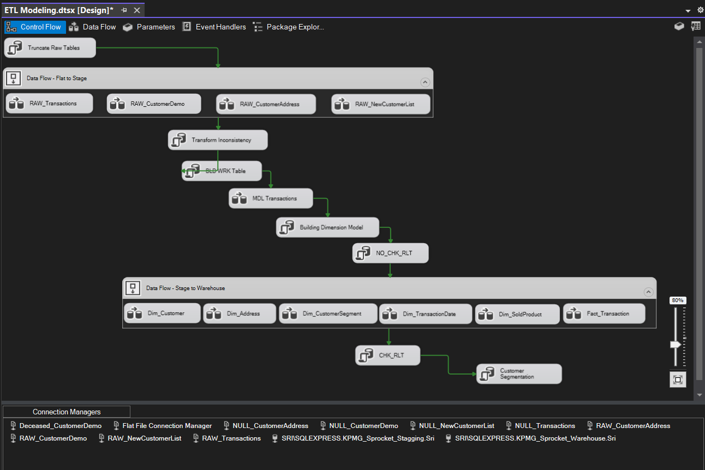
Data Pipeline (ETL-Extract, Transform & Load)

Slide 9
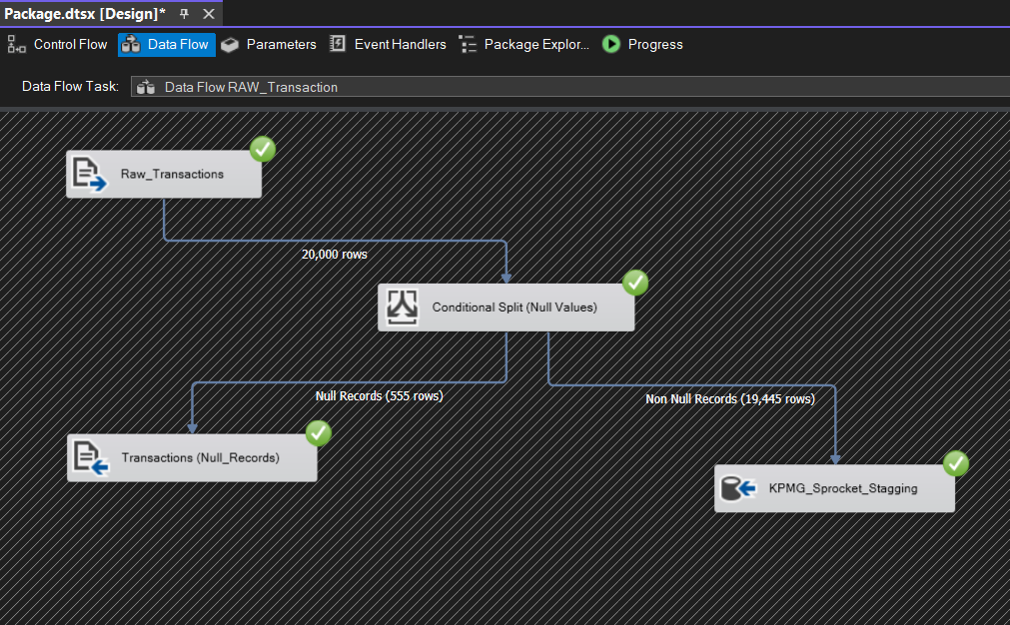
Data Flow Task 1

Slide 10
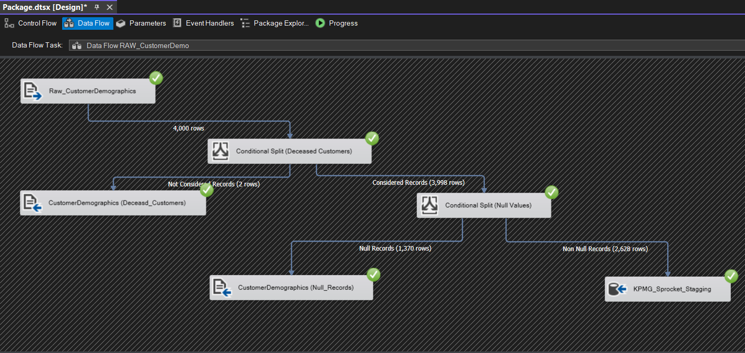
Data Flow Task 2

Slide 11
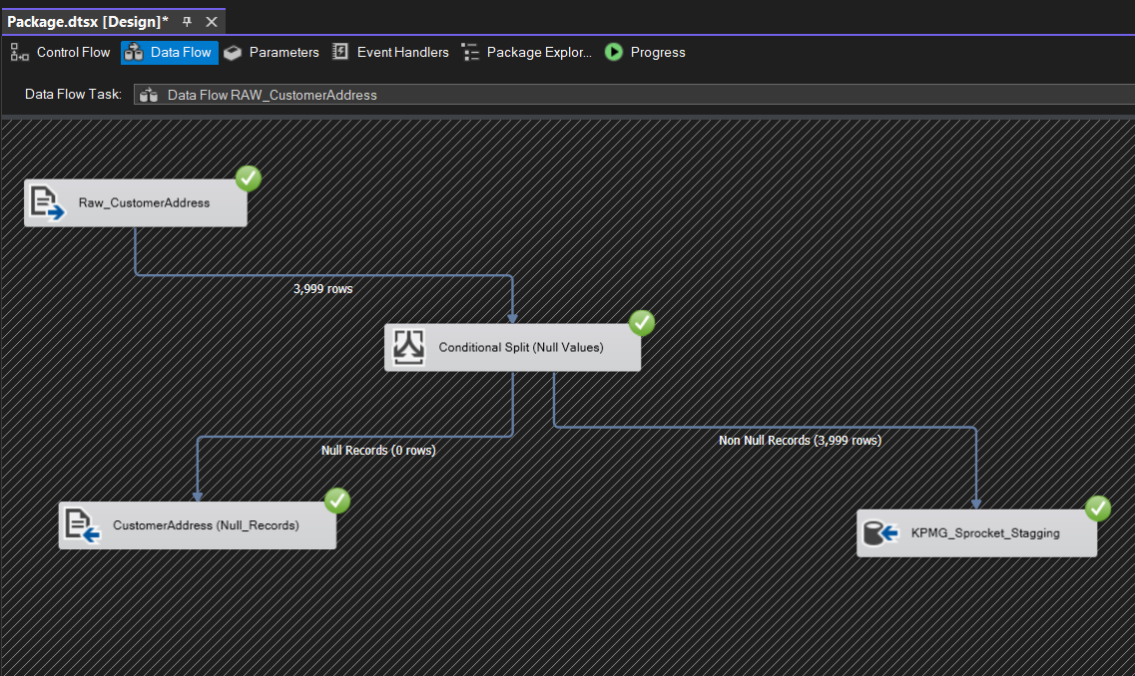
Data Flow Task 3

Slide 12
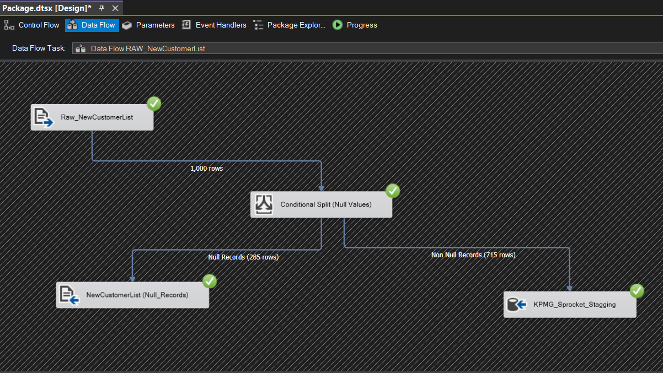
Data Flow Task 4

Slide 13
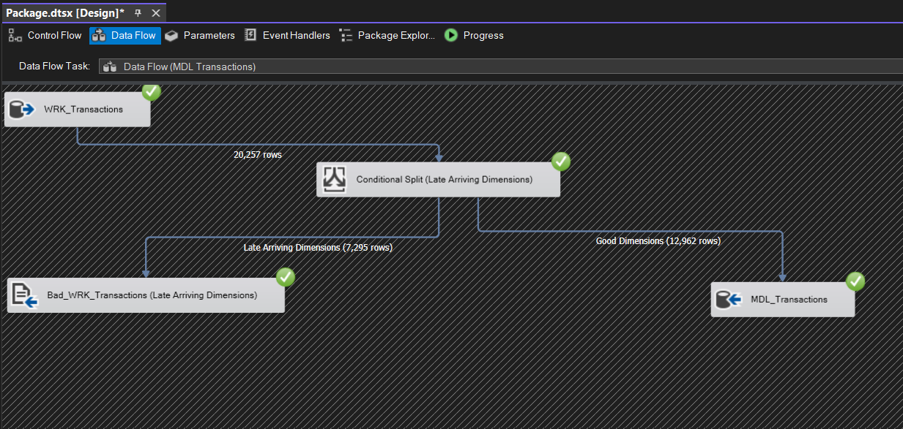
Data Flow Task 5

Slide 14
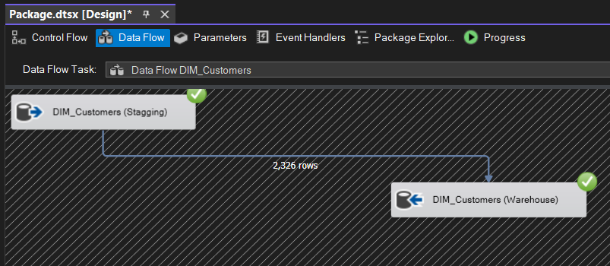
Data Flow Task 6

Slide 15
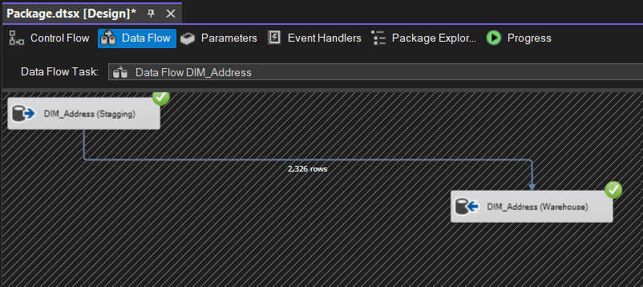
Data Flow Task 7

Slide 16
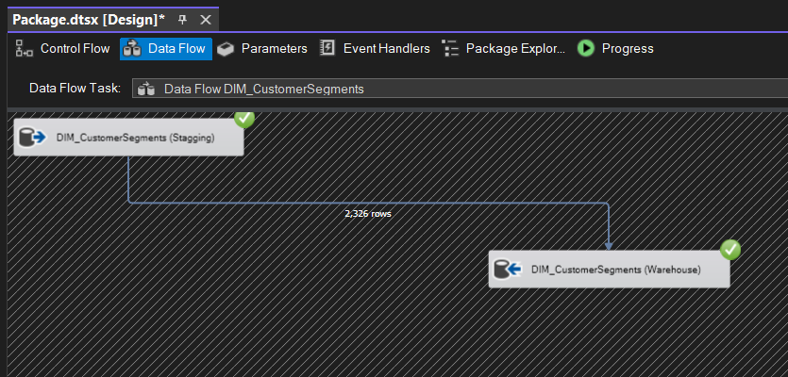
Data Flow Task 8

Slide 17
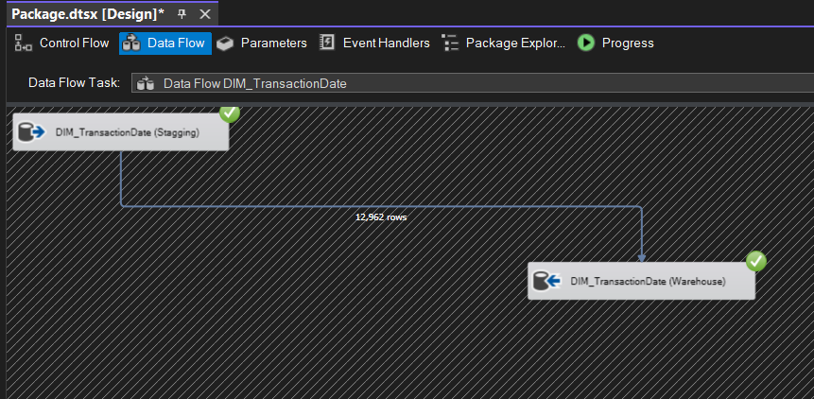
Data Flow Task 9

Slide 18
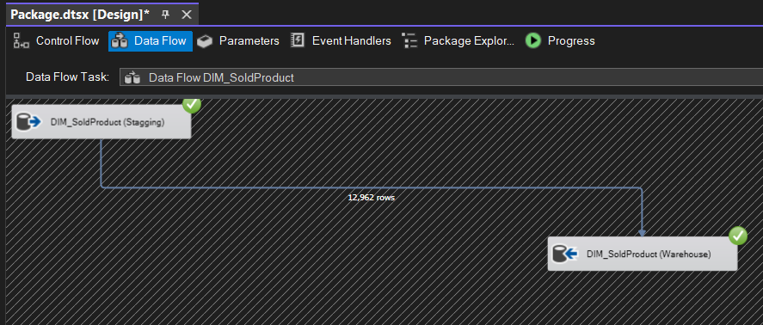
Data Flow Task 9

Slide 19
Data Flow Task 10

Slide 20
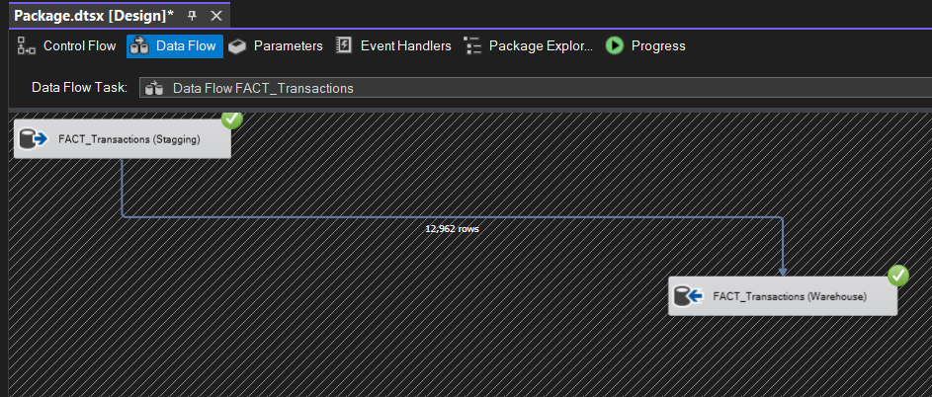
Data Flow Task 11

Slide 21
Data Modeling (Dimensional Modeling – Star Schema)
Derived Age column from DOB and made into groups.
Tenure Column is derived into groups.
Derived Profit column by subtracting List Price and Standard Cost.
Created Transaction Date Dim a dimension table from the transaction date column.
Used DAX to Calculate important metrics.
Developed Dimensional Data modeling to establish relationship between these tables.

Slide 22
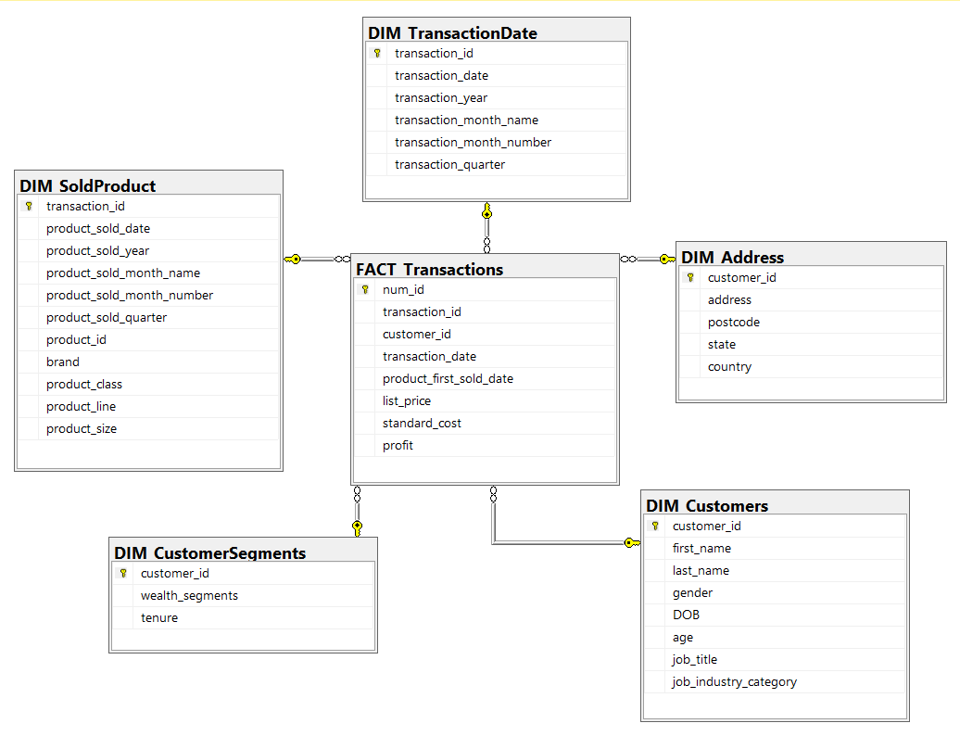
Data Modeling (Dimensional Modeling – Star Schema)

Slide 23
Customer Segmentation (RFM Segmentation)
Developed a Customer Segmentation Model using Recency, Frequency & Monetary values.
Recency Values provides us the Rank based on how recently the customers makes purchases with the Store.
Frequency Values provides us the Rank based on how frequently the customers makes purchase with the Store.
Monetary Values provides us the Rank based on how much profit value the customers makes with the Store.
Customer Segments:
Tier 1 Customer
Tier 2 Customer
Tier 3 Customer
Tier 4 Customer
Tier 5 Customer
Tier 6 Customer

Slide 24
Data Visualization & Dashboard
Data Visualization Dashboard was built on Tableau to provide insight on the Data Warehouse to the Clients on the level of Sales, Product and Customer Performances.
Further Slides consists of Dashboard Images that was built to showcase some of the insights.

Slide 25
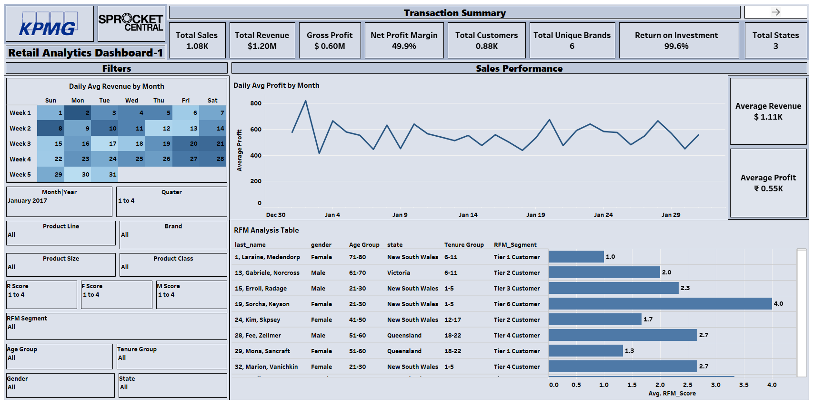
Data Visualization & Dashboard
Dashboard 1 – Sales Performance

Slide 26
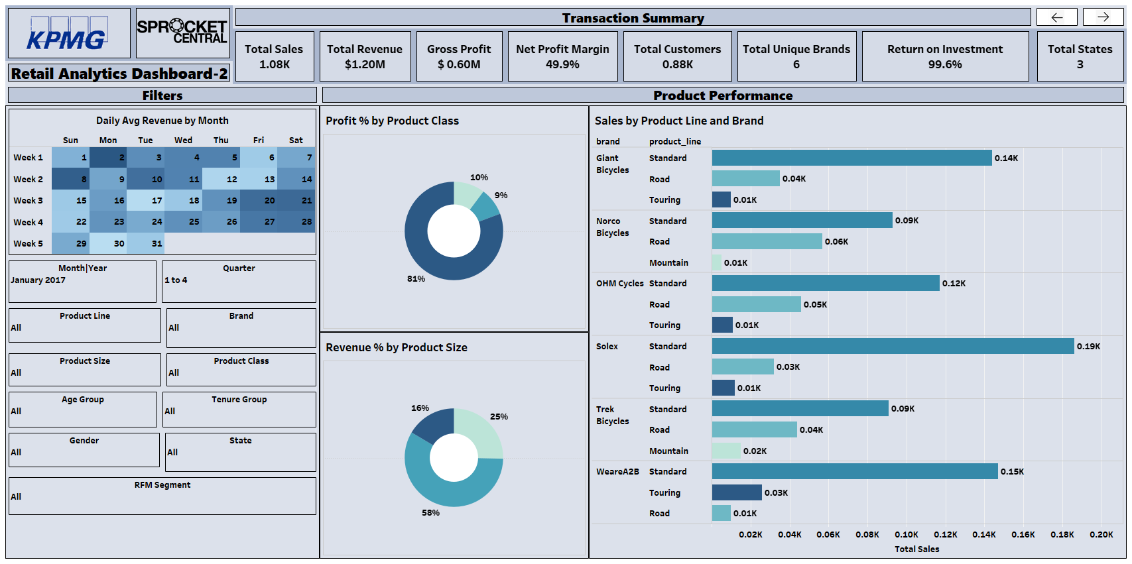
Data Visualization & Dashboard
Dashboard 2 – Product Performance

Slide 27
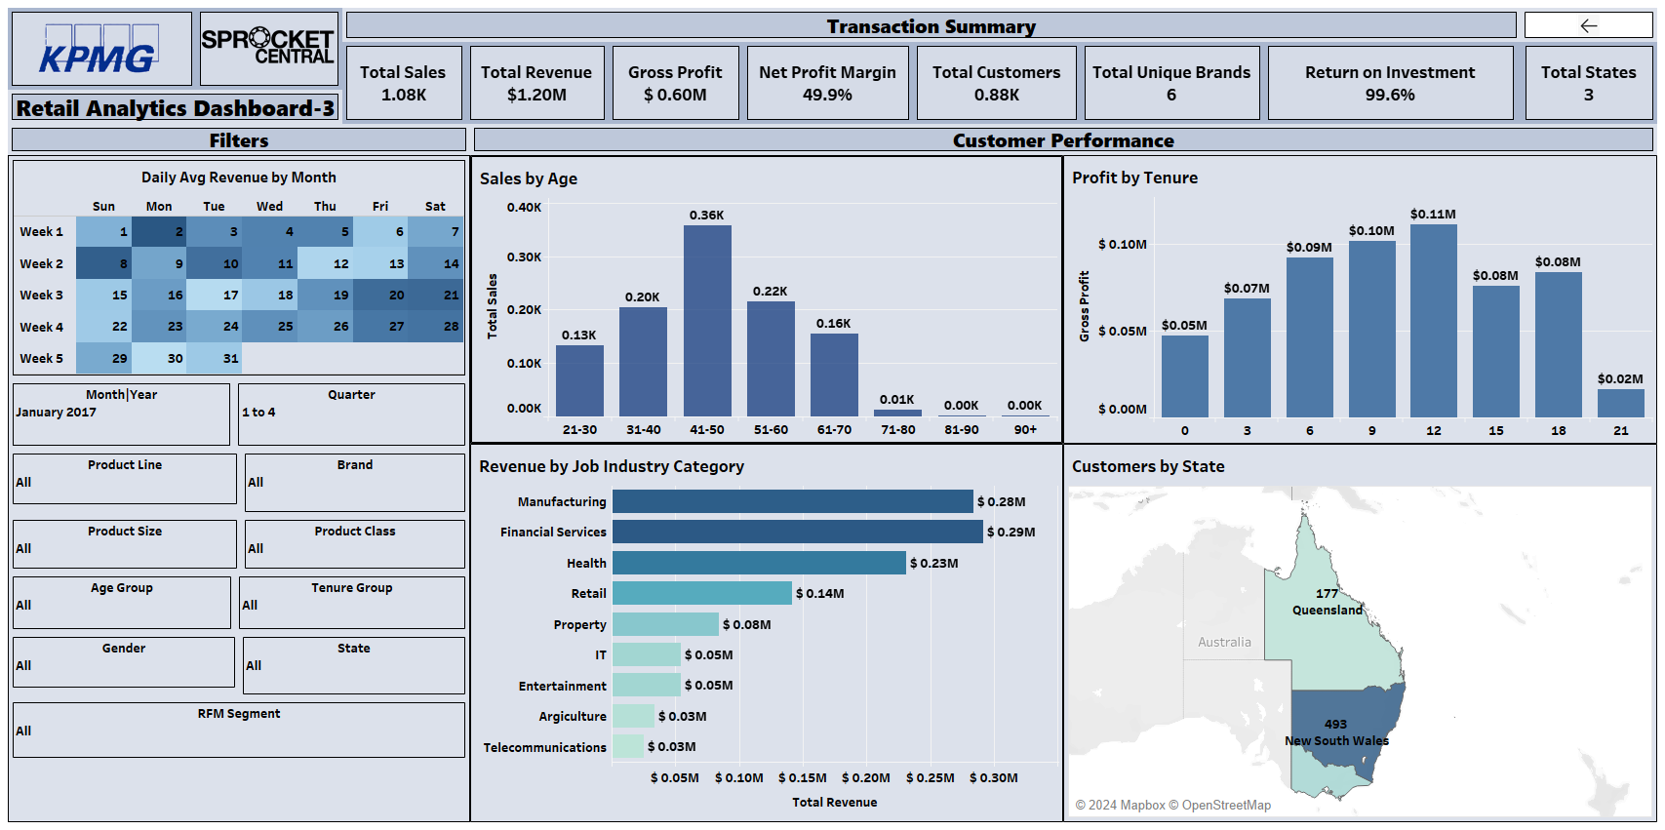
Data Visualization & Dashboard
Dashboard 3 – Customer Performance

Slide 28
Exploratory Data Analysis & Statistical Testing
Exploratory Data Analysis (EDA) was conducted on the Final Table which consist of Table Joins of Facts & Dimensions, and written inside Stored Procedures.
Uni-Variate, Bi-Variate & Multi-Variate Analysis was conducted using Python – Pandas, Seaborn libraries.
Advanced Statistical Tests were conducted using Python to validate some of the Conclusion against Null Hypothesis with alpha value of 0.05,
especially:
1) Chi Square Test, it was conducted to Test the independence of categorical variable
2) ANOVA Test, Analysis of Variance is conducted to test the Distribution of Groups among the Numerical Metrics.
3) Pearson’s Correlation Test, conducted to test the Linear Relationship among the Numerical Variables.

Slide 29
Conclusion
Therefore after conducting the following Analysis and Statistical Tests, we can conclude that our Data Pipeline and the Segmentation Model did the best on identifying our potential Customers.

Slide 30
END
Thank You.
Srikrishnan S
Email: srikrishnan214@gmail.com

